Slide 1
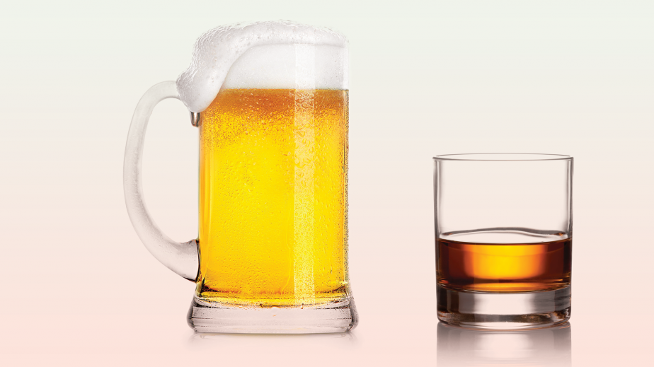

Beer vs Cocktails
Pick Your Poison

Slide 2


Team members
Maria Cabral
Ruslan Tugov
Michael Boynton
Jemall Brown

Slide 3


Project concept
It’s almost like comparing apples to oranges, but we wanted to display a choice to users from the moment they enter the site.
The idea is that once they choose their “poison,” we can either display a list of breweries which they can then visit the website for.
If they choose beer, they can search for a list of breweries by state or by using a key word which may be in the name of the brewery. If they’re adventurous, they can event get in the car and drive to the location because we provide a map.
If they choose “cocktail,” they can search for a drink type by either ingredient or name. Afterwards, they will be provided with the recipe and necessary ingredient to make the drink themselves.

Slide 4
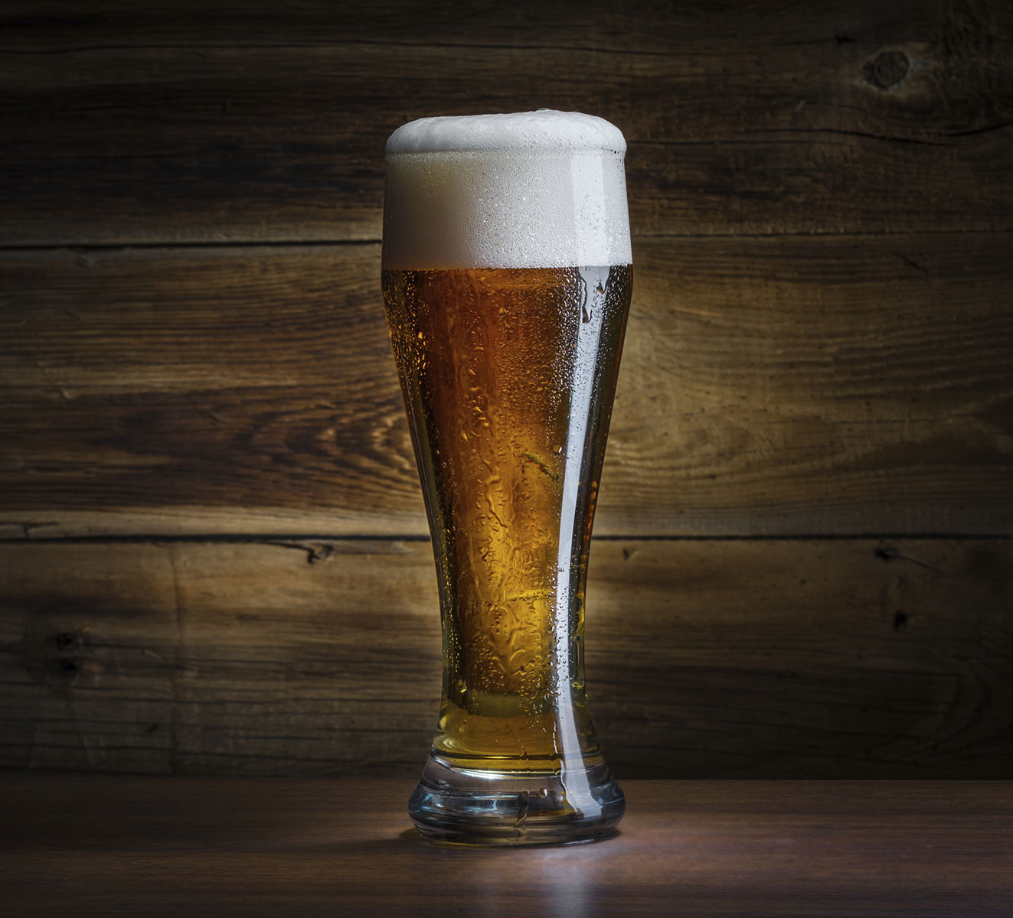
Tech used
Google Maps API
thecocktaildb.com/api
api.openbrewerydb
Jquery
Javascript
Ajax
Bootstrap
Local storage
HTML
CSS

Slide 5
Code we are proud of
// function to load favorites to buttons on page
function getLocalStorageFavs(){
if (localStorage.getItem("favoriteBreweryId")=== null){
return;
};
favIdArray = JSON.parse(localStorage.getItem("favoriteBreweryId"));
favNameArray = JSON.parse(localStorage.getItem("favoriteBreweryName"));

Slide 6
Code we are proud of
function searchTriggered(arg1,arg2) {
$("#brewery-view").empty();
var queryURL = "https://api.openbrewerydb.org/breweries?by_name=" + arg2 + "&by_state=" + arg1
$.ajax({
url: queryURL,
method: "GET"
}).then(function(response){
if (response.length === 0){
$("#nothingFound").show();
$("#nothingFound").text( "Sorry. Nothing found. Please search again." );
return;
}
//after search, need to hide the place holder image
$("#beerPlaceHolderImg").hide();

Slide 7
Ideas for the future
Add reservation button to beer page that would allow people to book tours for a brewery through our website
Add ingredient buying system for the recipe application on cocktail page and link it to liquor stores.
Add page or space for blog posts
Add field for ranking of breweries or cocktails based on “likes”
Add membership section where people can sign up to receive notifications when the site is updated.

Slide 8

Road blocks
Initial APIs did not perform as expected. Had to switch gears after 1.5 weeks of coding effort.
Initial issues with local storage. Had to figure out how to make the storage a usable array.

Slide 9


The end

